Slide 1
MACHINE LEARNING
An introduction

Slide 2
What is machine learning?
Human Learn from Experience
Machine Learn from Data

Slide 3
How humans make decision?

Slide 4
How machines make decision?
Data
Features
Label

Slide 5
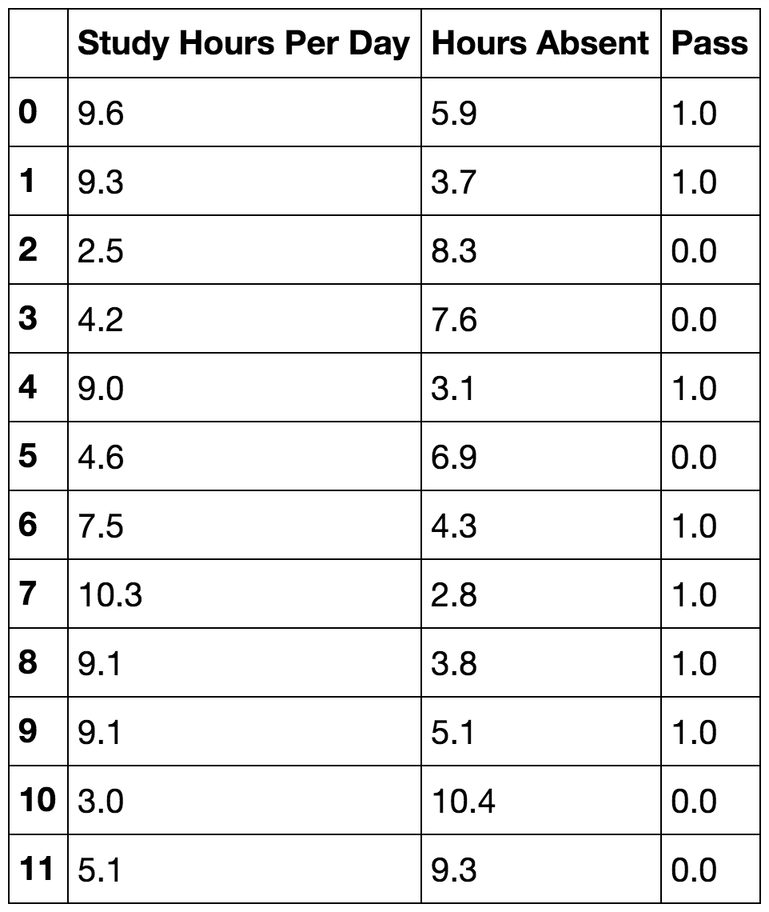
Prof. Gilbert Algebra Class

Slide 6
Machine learning just around the corner
Object Recognition
Digit Recognition

Slide 7
Machine learning just around the corner
Detection of Heart Arrhythmias
using wearable devices
Prediction of Future Sales

Slide 8



3 Different types of machine learning
Regression
Classification
Reinforcement Learning

Slide 9



STEPS
Data
Pre-processing
Feature Extraction
Exploratory Analysis
Visualization
Standardization
Imputation of missing values
Modelling
Training the Model
Testing the model
Linear and Non Linear Transformation
Dimensional Reduction
Splitting of Dataset
Parameter Tuning

Slide 10
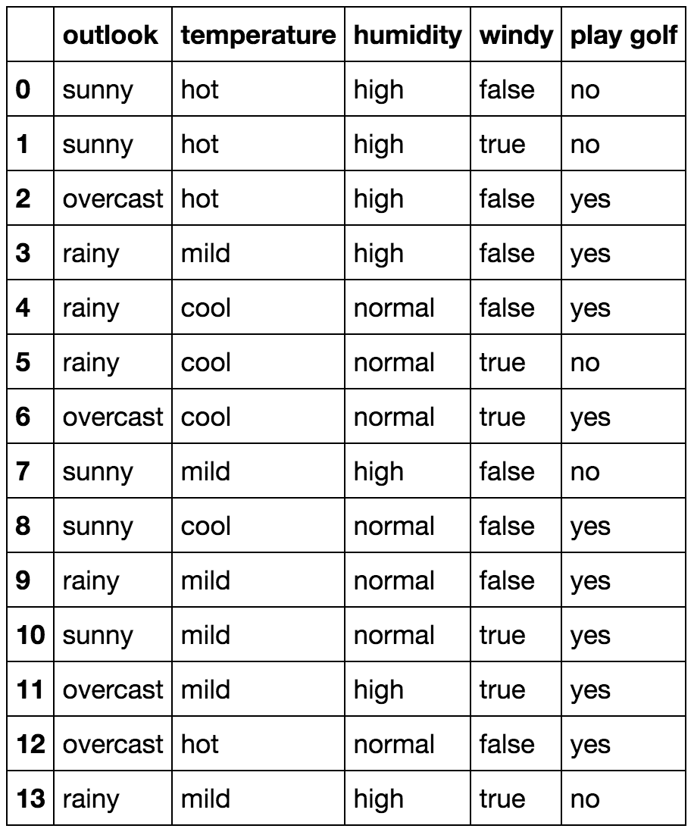
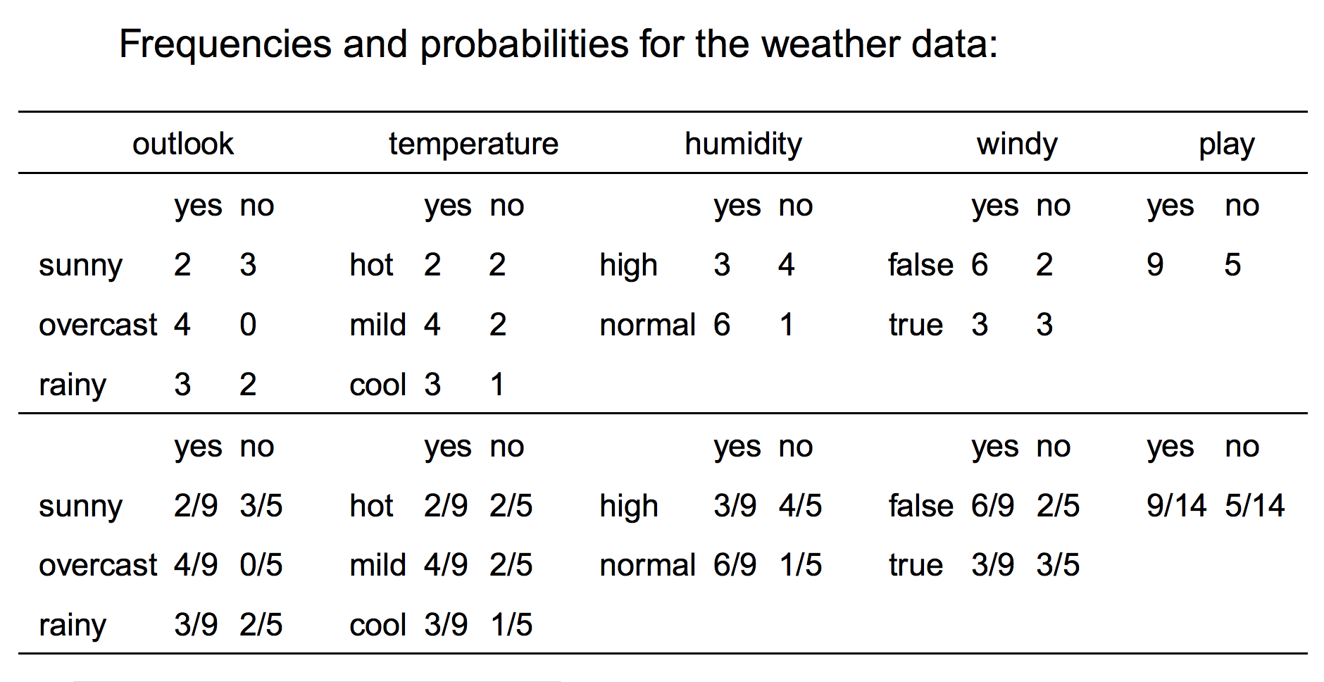
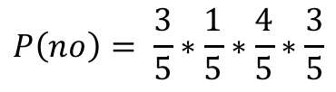
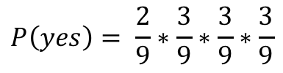
Naïve bayes
Outlook | Temp. | Humidity | Windy | Play Golf
sunny | cool | high | true | ?
$$P\left(yes\right)= \frac{2}{9}∗\frac{3}{9}∗\frac{3}{9}∗\frac{3}{9}$$
$$P\left(no\right)= \frac{3}{5}∗\frac{1}{5}∗\frac{4}{5}∗\frac{3}{5}$$

Slide 11
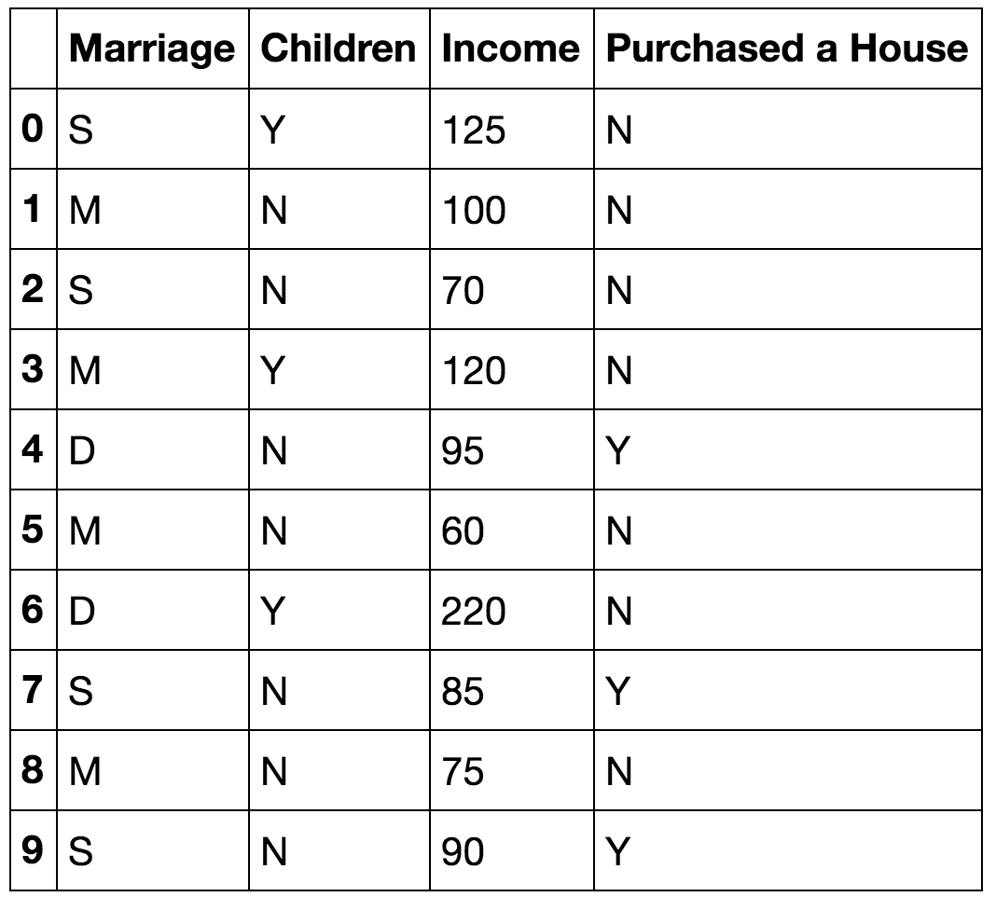
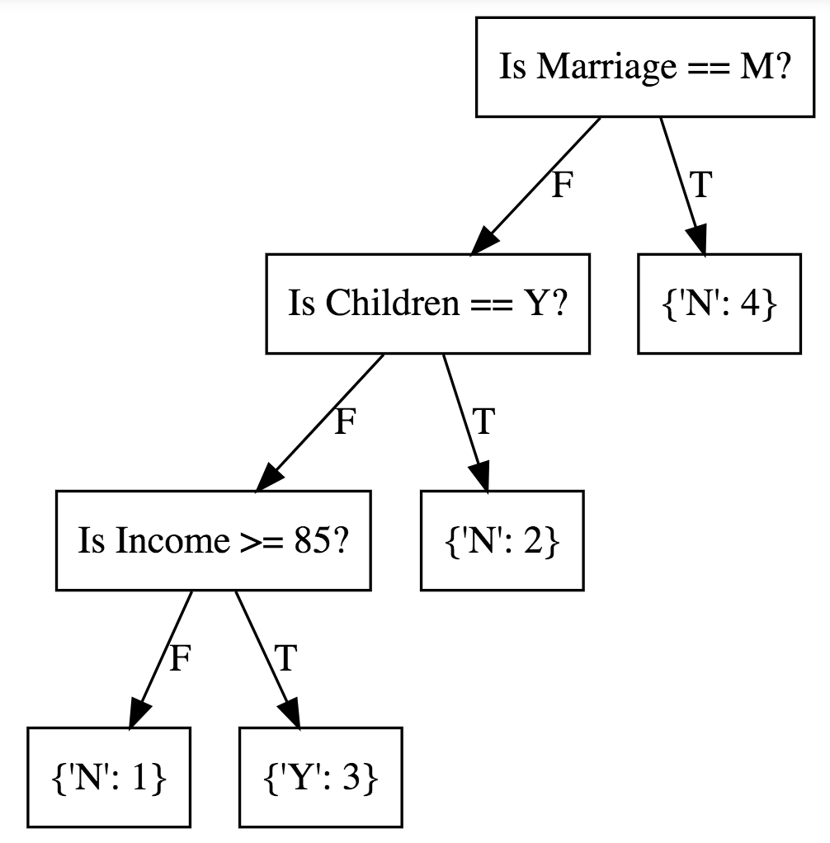
Decision tree

Slide 12
Random forest
Decision Tree 1
Decision Tree 2
Decision Tree 3
Decision Tree 4
Vote = Y
Vote = N
Vote = Y
Vote = Y
Majority Vote = Y

Slide 13
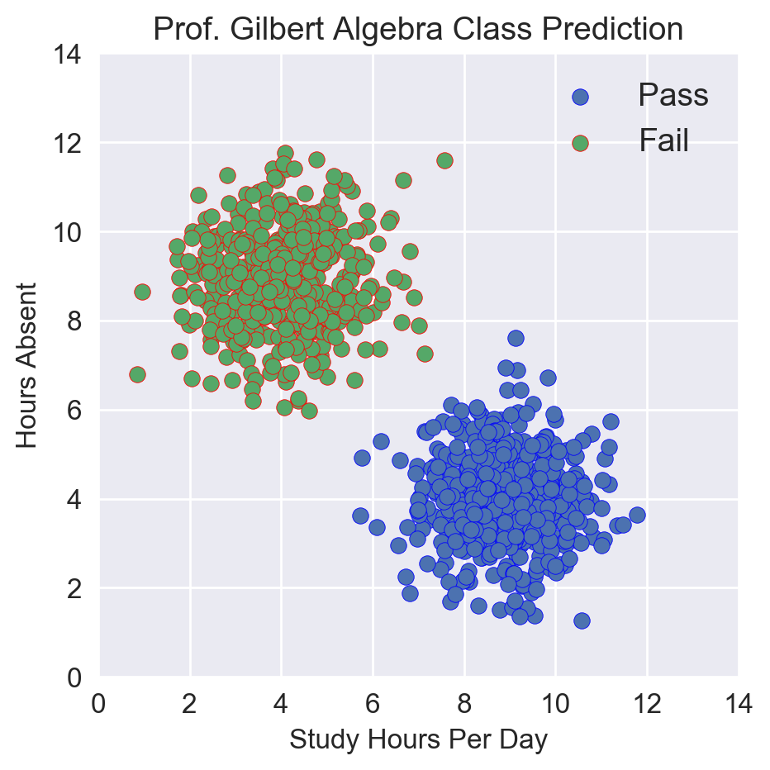
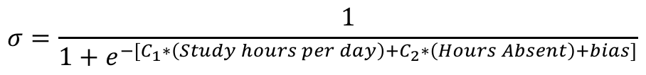
Gradient Descent
Cost Function : Cross Entropy Loss
$$σ=\frac{1}{1+e^{−[C_{1}∗\left(Study hours per day\right)+C_{2}∗\left(Hours Absent\right)+bias]}}$$

Slide 14
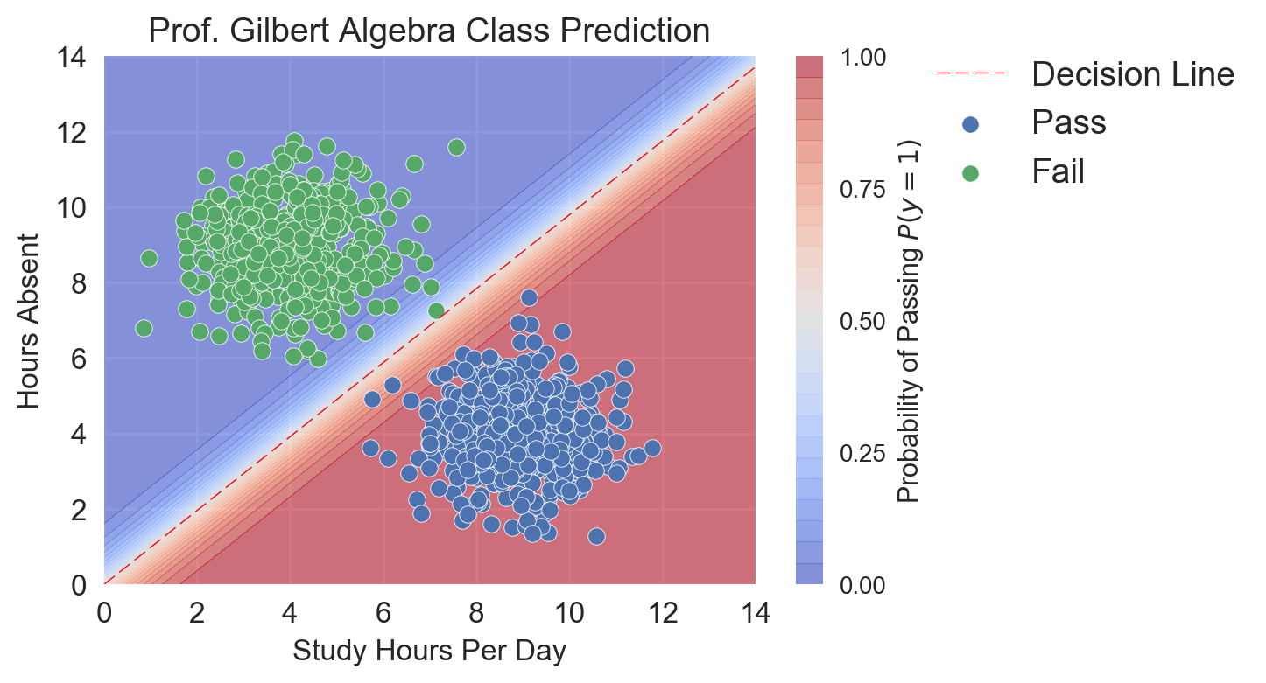



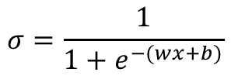
Logistic regression
$$σ=\frac{1}{1+e^{−(wx+b)}}$$

Slide 15
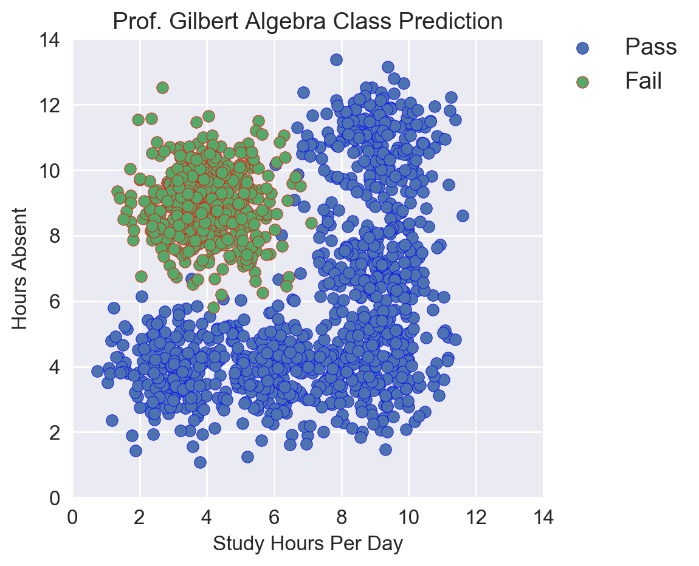
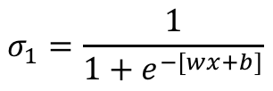
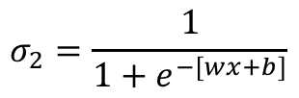
$$σ_{1}=\frac{1}{1+e^{−[wx+b]}}$$
$$σ_{2}=\frac{1}{1+e^{−[wx+b]}}$$

Slide 16
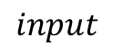


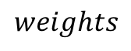
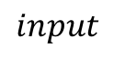
$$input$$
$$input$$
$$weights$$
$$weights$$
$$weights$$

Slide 17
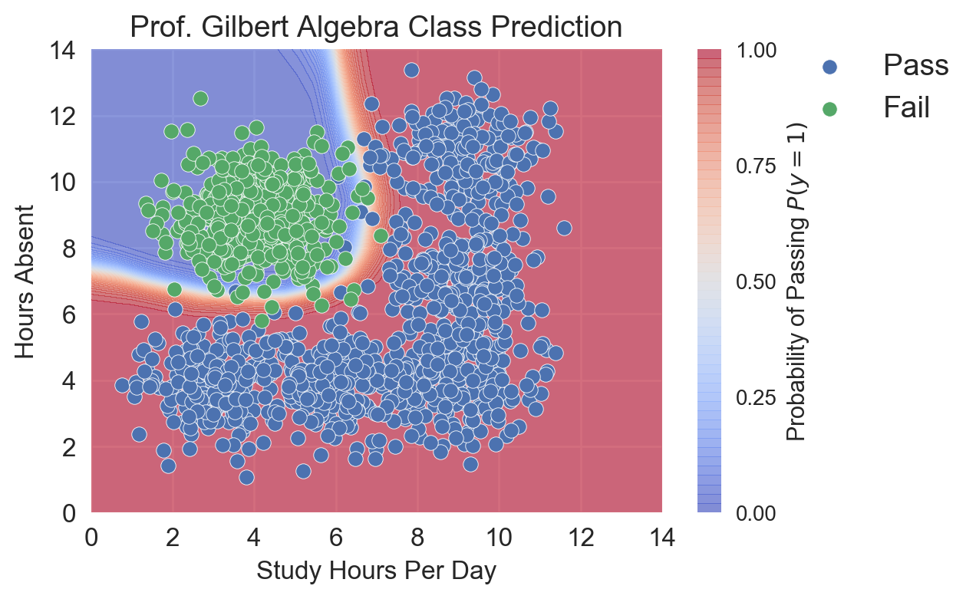
Neural network

Slide 18
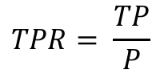
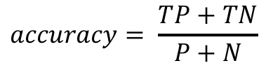
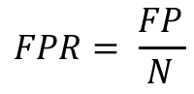
performance metrics
Accuracy
True positive rate
False positive rate
$$accuracy= \frac{TP+TN}{P+N}$$
$$TPR= \frac{TP}{P}$$
$$FPR= \frac{FP}{N}$$

Slide 19
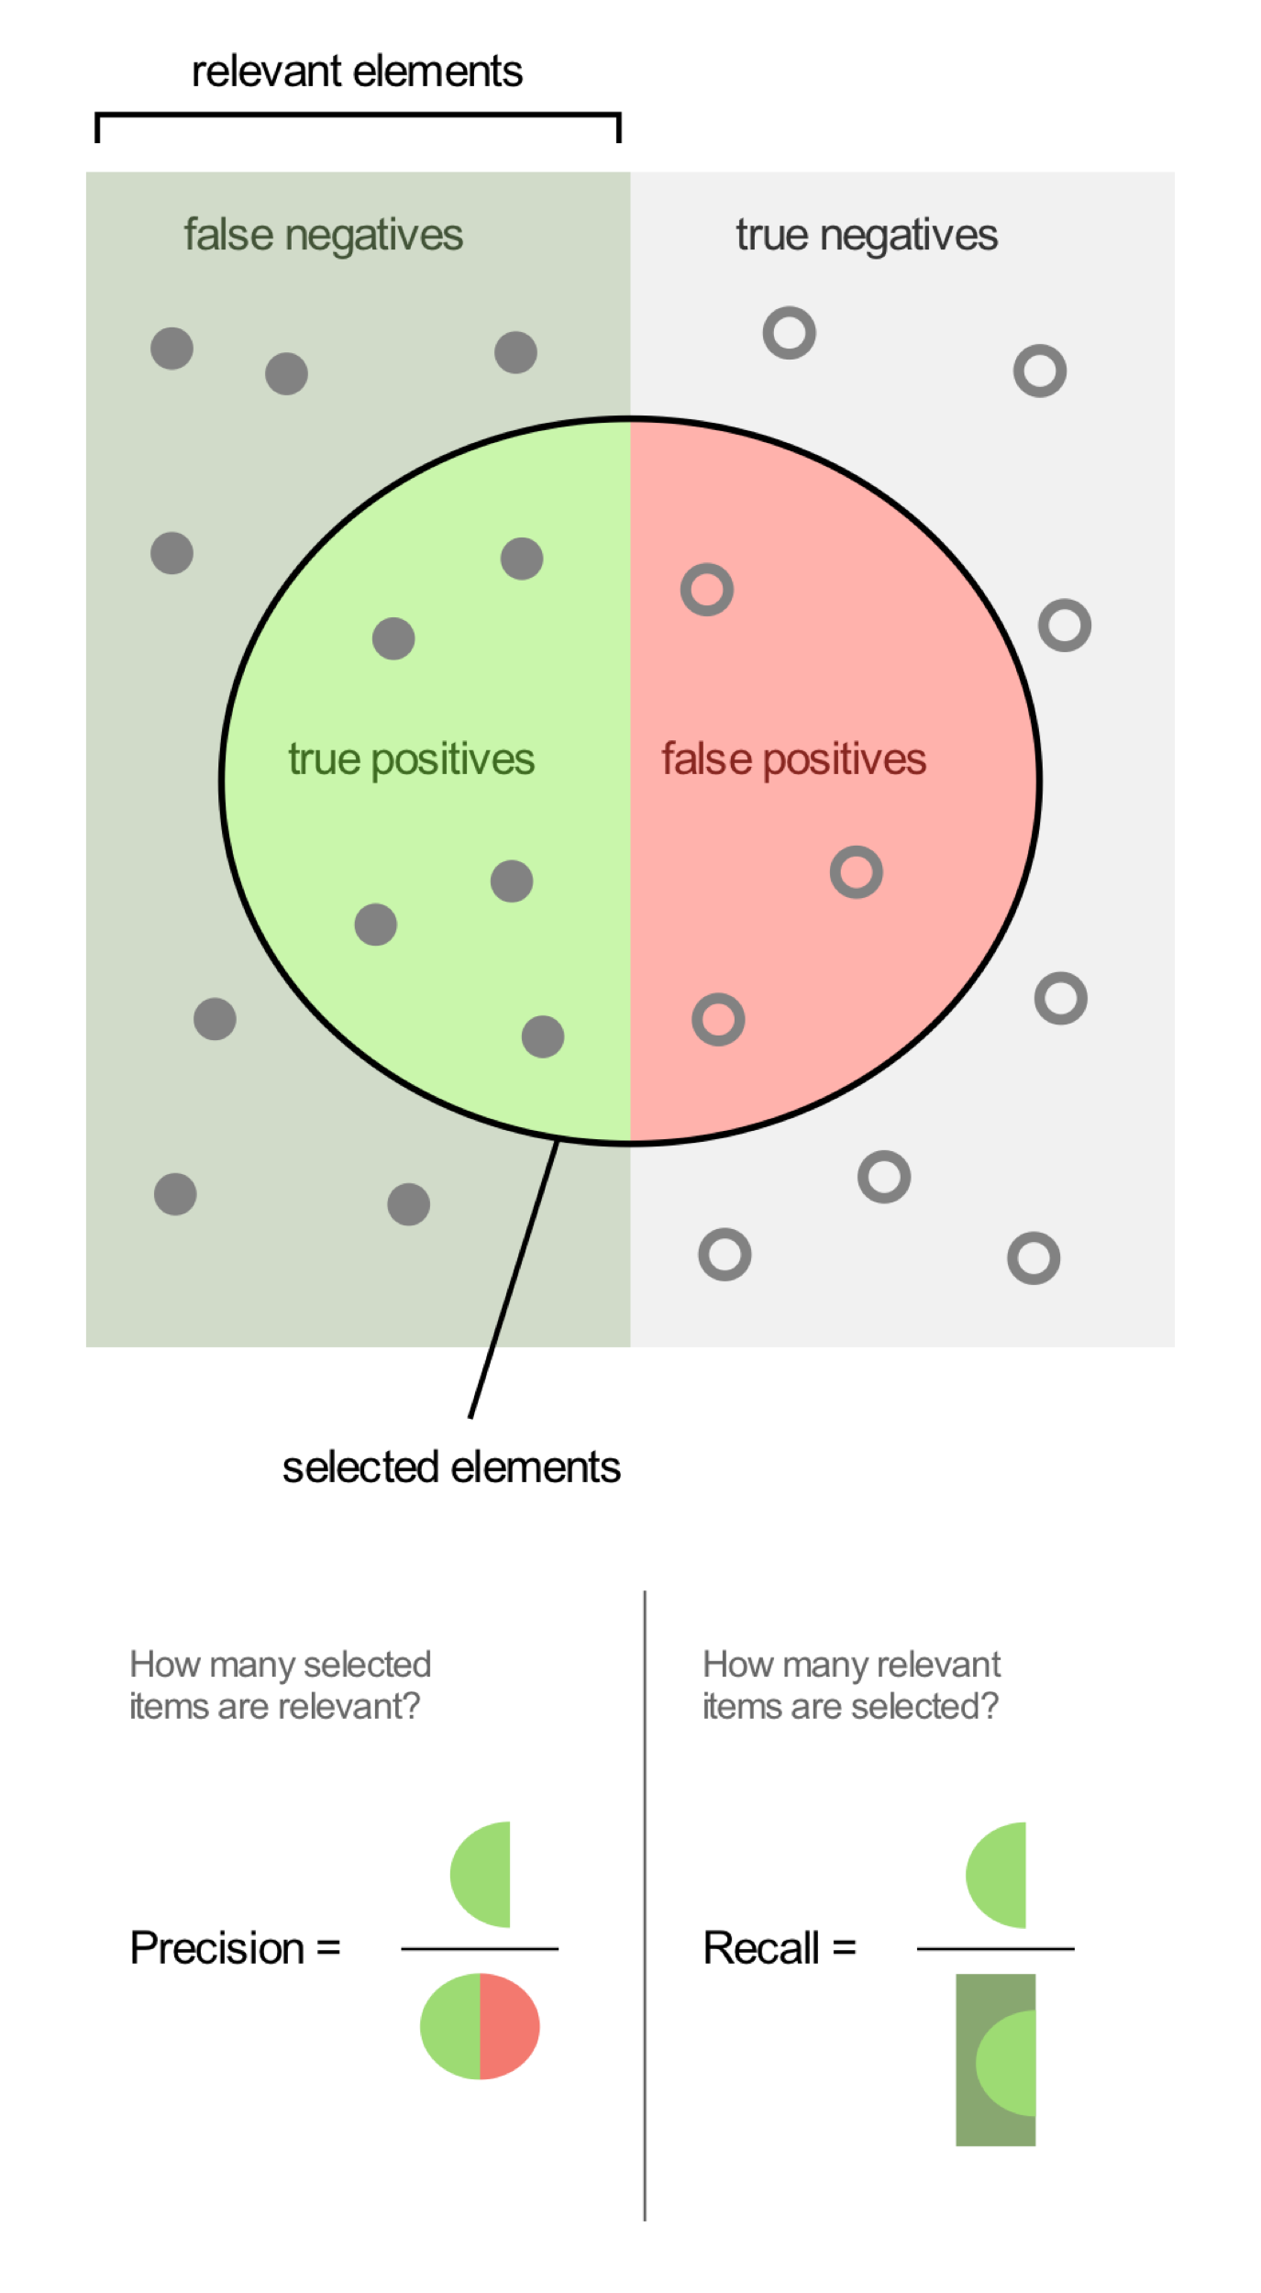
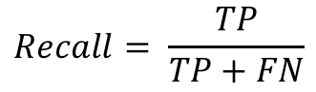
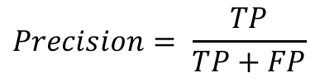
performance metrics
Precision
recall
$$Precision= \frac{TP}{TP+FP}$$
$$Recall= \frac{TP}{TP+FN}$$

Slide 20
Model parameter tuning
Feature Extraction
Modelling
Parameter Tuning
Pre-processing
Performance Metrics

Slide 21
Classification models
Naive bayes
Decision tree
Random forest
Logistic regression
Neural network

